Slide 1
Stem cell therapy

Slide 2
What is stem cell?
Stem cells are unspecialized or undifferentiated cells that have the unique ability to give rise to many different cell types such as skin, liver, kidney, heart, neuron or other organ cells.
They have the ability to proliferate and self-renew under certain conditions and differentiate into many other functional cells.
These cells are capable of performing three important function with unique abilities:
plasticity: potential to change into other cell types like nerve cells.
Homing: to travel to the site of tissue damage.
Engraftment: to unite with other tissues

Slide 3
There are two ways to classify stem cells:
totipotent stem cells (TSCs)
Each cell can develop into a new individual
Cells from early (1-3 days) embryos
pluripotent stem cells (PSCs)
Cells can form any (over 200) cell types
Some cells of blastocyst (5 to 14 days)
unipotent stem cells (USCs)
Cells differentiated, but can form a number of other tissues
Fetal tissue, cord blood, and adult stem cells
developmental stages
embryonic stem cells (ESCs)
are separated from the blastocyst cell cluster
adult stem cells (ASCs)
exist in various adult tissues
can be divided into:
mesenchymal stem cells (MSCs)
hematopoietic stem cells (HSCs)
neural stem cells (NSCs)
induced pluripotent stem cells (iPSCs)
and the like
differentiation potential

Slide 4
What is stem cell therapy?
a form of regenerative medicine designed to repair damaged cells within the body by reducing inflammation and modulating the immune system. This phenomenon makes stem cell therapy a viable treatment option for a variety of medical conditions.
Stem cell therapies have been used to treat autoimmune, inflammatory, neurological, orthopedic conditions and traumatic injuries.
While stem cell therapy does not necessarily provide a cure for these conditions, the premise is to allow the body to heal itself well enough to mitigate the symptoms of the conditions for long periods.
In many cases, this effect can substantially increase the quality of life for patients as well as delay disease progression.

Slide 5
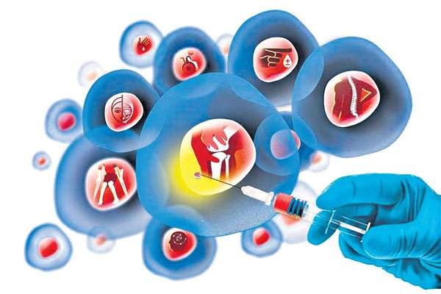
Diseases cured by stem cell therapy
Spinal cord injuries
Diabetes mellitus
Cancer
Stroke
Heart damage (Myocardial infarction)
Tooth implanting
Deafness and blindness
Baldness
Gastrointestinal disease
Liver disease
Dermatology

Slide 6
Stem Cell Therapy for
Spinal Cord Injury

Slide 7
Spinal Cord Injury (SCI)
is one of the most serious neurological diseases in the world. Due to the high disability rate, SCI brings a high economic burden to the society.
Despite the studies focused on SCI have been carried out for decades, the surviving patients of this disease will inevitably leave long-term and severe neurological damage.
According to previous researches, there are many risk factors for traumatic SCI including violence, extreme sports, and accidents.
Studies have reported that more than 23% of SCI patients have had secondary injuries within 10 years. Alcoholism, the use of psychotropic drugs, and some personality traits are all related to the occurrence of secondary injury.

Slide 8
Spinal Cord Injury (SCI) contd.
pathological mechanism of SCI:
primary injury: When the spinal cord is subjected to contusion, tearing or compression due to external forces, or infarction due to vascular injury, the spinal cord begins to have nerve damage, which is often referred to as primary injury.
secondary injury: After the primary injury occurs, a large number of nerve cell death occurs, and the blood-spinal cord barrier is destroyed. Subsequently, a series of damage reactions such as vasospasm hemorrhage, reactive oxygen species (ROS) formation, lipid peroxidation, inflammation, and apoptosis occur, leading to secondary cascade reaction which further aggravates the damage.
At present, the main methods for the treatment of SCI include:
surgical treatment
drug treatment
hyperbaric oxygen therapy
physical therapy
However, the therapeutic effects and the outcome of patients with SCI remain unsatisfactory. This requires us to study new and effective methods for the treatment of SCI.
In recent years, stem cell (SC) treatment of SCI has gradually become a new research hotspot.

Slide 9
Common SC Types for SCI Treatment
Mesenchymal Stem Cells (MSCs):
Bone Marrow Mesenchymal Stem Cells (BM-MSCs)
Umbilical MSCs (U-MSCs)
Adipose-derived MSCs (AD-MSCs)
Embryonic Stem Cells (ESCs)
Induced Pluripotent Stem Cells (iPSCs)
NSCs and NPCs
Other SCs

Slide 10
Stem Cell Transplantation Strategy
Bone Marrow Mesenchymal Stem Cells (BM-MSCs)
The researchers have proved that transplanted BM-MSCs can pass the blood-brain barrier (BBB) without destroying their structure.
After transplantation, BM-MSCs can migrate to the injured area and differentiate into neurons or neuron-like cells, thereby exerting neuroprotective effects by secreting various neurotrophic factors, Including:
nerve growth factor (NGF)
brain-derived neurotrophic factor (BDNF)
and vascular endothelial growth factor (VEGF)
tropism to the injury sites and of interleukin-13 (IL-13), which is an inducer of the anti-inflammatory microglia/macrophage phenotype improved motor function recovery and decreased demyelination.

Slide 11
Genetic engineering of BM-MSCs:
encouraging method to enhance their therapeutic effect, such as the regulation of specific factors or proteins.
Insulin-like growth factor 1 (IGF-1) is an important factor for maintaining the characteristics of NPCs. IGF-1 overexpression of BM-MSCs strengthens antioxidant reactions.
Other approaches, such as:
silencing the Nogo receptor gene
inhibition of tumor necrosis factor α (TNF-α)
overexpression of:
neurotrophin-3 (NT-3)
chemokine stromal-derived factor-1
neurotrophic factor-derived glial cell (GDNF) genes
exhibited better efficacy than original BM-MSCs in motor function and surrounding axon densities.

Slide 12
Patients avoid immunoreaction by receiving autologous cell transplantation. Therefore, BM-MSCs have huge potential for SCI treatment due to their reduced immunogenicity and improved availability.
However, the therapeutic effects, homing ability, survival, and proliferation of single-cell types are limited. Further studies should focus on these aspects and combinational therapy to improve the efficacy of BM-MSC

Slide 13
Umbilical MSCs (U-MSCs)
U-MSCs possess the ability to develop into a homogeneous population that expresses neural markers and develops neural phenotypic features.
U-MSCs migrated into the injury site but not non injured areas after transplantation.
Umbilical-MSCs:
protected neurons from apoptosis
inhibited the formation of glial scars via regulation of MMP2
attenuated ischemic compromise of the spinal cord
decreased reactive astrocytes
improved motor function
alleviated allodynia and hyperalgesia after SCI in animal experiments

Slide 14
Genetic engineering of U-MSCs:
Wnt proteins:
are involved in neural precursor (NP) differentiation and axon development
Wnt-3a plays important roles in spinal cord dorsal interneuron differentiation
Established Wnt3a-secreting U-MSCs by gene modification
To enhance the efficacy of U-MSCs
U-MSCs are conveniently obtained because the umbilical cord is generally discarded.
U-MSCs are obtained from umbilical blood, perivascular regions, and the umbilical vein subendothelium without ethical issues, and these cells are beneficial in the recovery of SCI via different mechanisms.

Slide 15
Adipose-derived MSCs (AD-MSCs)
AD-MSCs and BM-MSCS
Similarities:
Morphology
cell surface antigen expression
therefore;
AD-MSCs is
a good candidate for MSCs, especially with adipose tissue availability.
Differences:
proliferation rates
multilineage capabilities
more somatic stem cells in
adipose tissue

Slide 16
Adipose-derived MSCs (AD-MSCs) contd.
Intravenous administration of AD-MSCs activates angiogenesis
upregulates ERK and Akt, which improves hindlimb motor function.
promote cell survival and tissue repair by increasing the expression of beta3-tubulin ,BDNF, and ciliary neurotrophic factor (CNTF)
human adipose-derived stem cells transdifferentiate into neuron/motoneuron-like cells, which reduce the formation of cavities and suppress immune activity via the inhibition of astrocyte reactivation and secretion of anti-inflammatory factors
Although AD-MSCs transplantation has been investigated in animal SCI models, large longitudinal clinical trials using stem cells derived from adipose tissue are lacking.
Early studies investigating the safety of intravenous AD-MSCs showed no tumorigenicity or other adverse side effects.

Slide 17
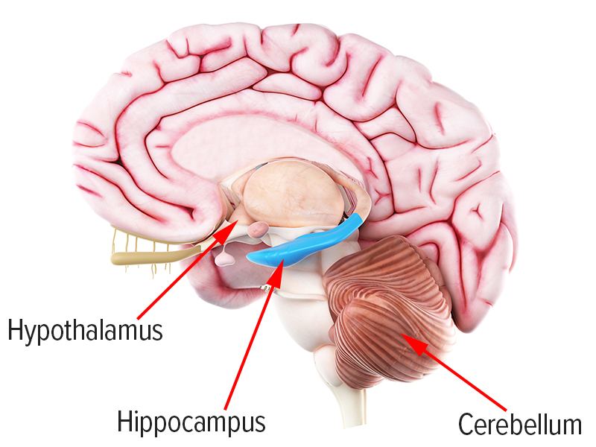
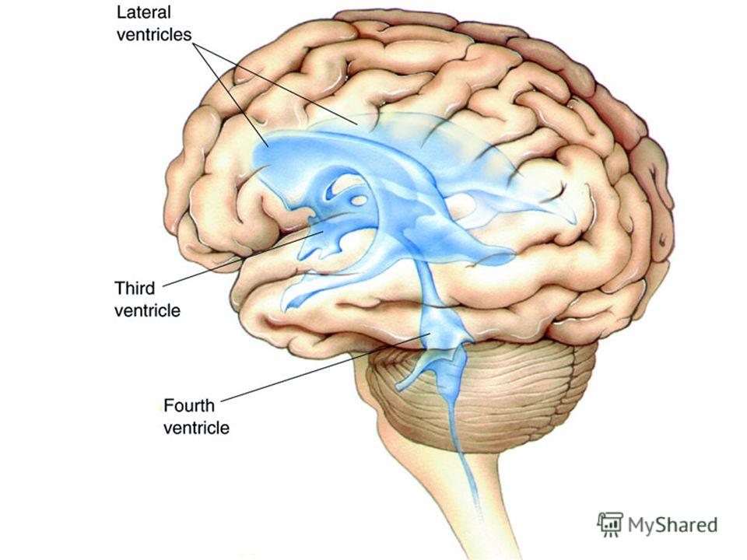
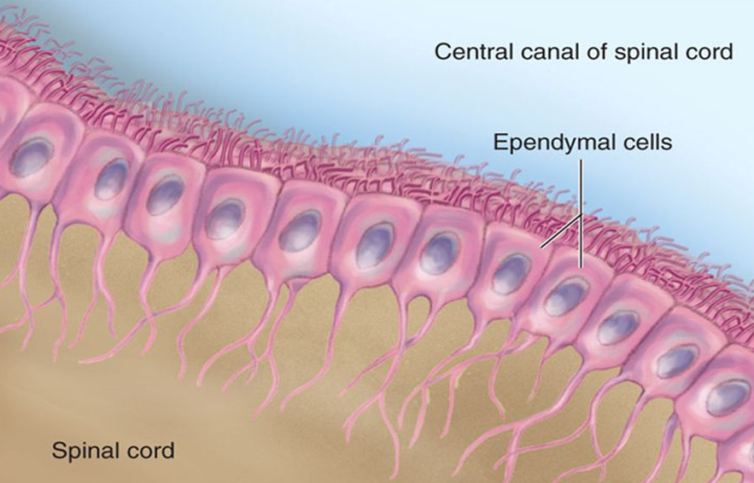
NSCs and NPCs
They are pluripotent cells that are isolated from:
the subventricular region of the ventricles
hippocampus of the brain
the ependymal region of the central canal of the spinal cord

Slide 18
These cells are capable of differentiating into specific neuronal or glial cells, enhancing remyelination and providing nutritional support, which makes them suitable for cell transplantation therapy.
NPCs primarily differentiate into oligodendrocytes, increase myelination, and improve hindlimb function.
NPC transplantation increased the expression of NGF, CNTF, BDNF, IGF-1, and GDNF, which are beneficial for SCI recovery.
NPCs also modulate the inflammatory response via inhibition of the secretion of reactive macrophages and T cells and neuroprotective cytokines.

Slide 19
Modified NSCs:
Transplantation of recombinant NSCs with VEGF:
transient receptor potential vanilloid (TRPV1)
promoted neuronal recovery
the release of neurotrophic factors
NSCs with high expression of E-cadherin:
increased the survival of NSCs
decreased the release of inflammatory factors
promoted functional recovery
Overexpression of the antiapoptotic gene Bcl-XL105 also achieved better recovery.

Slide 20
Induced Pluripotent Stem Cells (iPSCs)
iPSCs are generated from reprogrammed somatic cells, which are separated from accessible tissue, such as autologous skin, which avoids ethical issues, allows autologous cell transplantation, and prevents rejection.
The use of iPSCs to treat SCI is still in the experimental stage.
A comparative study demonstrated that iPSC-NPs exhibited the best effect due to their strong graft survival, glial scar inhibition, and axonal sprouting enhancement compared to those of BM-MSCs and NPs derived from an immortalized spinal fetal cell line.
The tumorigenesis of iPSCs and the prohibitively high cost–benefit for developing treatments142 hinder the clinical translation.

Slide 21
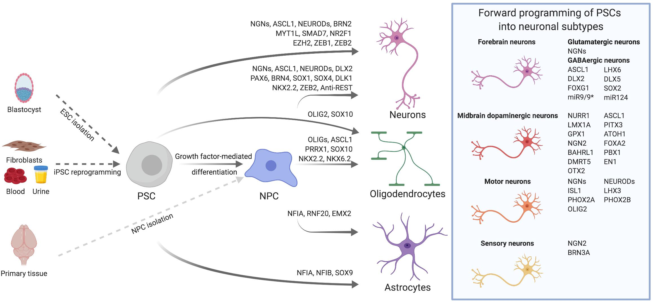

Slide 22
Pathways of Transplantation
There are many pathways to transplant SCs in various SCI models, including intravenous, trans arterial, nasal, intraperitoneal, intrathecal, and intramedullary injections.
It was concluded that various routes of SC administration was feasible for the treatment of SCI.
Intravenous administration
Intramedullary injections
Invasive
does not damage the spinal cord tissue
large number of cells that can be administered at one time
SCs can also migrate to the injury site
easy to cause blood vessel embolism
are more effective than intravenous
injection
Intrathecal injection
Intranasal administration
is less invasive than intramedullary injection
can reduce the host's immune response
BM stromal cells can migrate to the
injured spinal cord
reduction of the damage cavity
recovery of hindlimb motor function

Slide 23
Number of SCs
An insufficient number of transplanted cells will make it difficult to exert therapeutic effects.
Most studies of the SC treatments for SCI used a number of cells ranging from tens of thousands to millions and had significant therapeutic effects.
However, the number of cells used in SC therapy is not the more the better.
One possible explanation for these results is that the high number of transplanted cells in the high-dose group produces or integrates a large number of mature neurons, which can negatively regulate the spinal cord in the absence of external intervention, thereby affecting the expected therapeutic effect of SC treatment .
Therefore, the number of effective SCs for the treatment of SCI is still not very clear, which needs further study.

Slide 24
Stem cells therapy for
diabetes mellitus type 1 & 2
Diabetes results from the loss of 'beta' cells in the pancreas that make insulin, the hormone which acts to lower blood sugar. Diabetic patients have to take insulin injections lifelong.
Adult stem cell therapy with autologous stem cells fights type 1 and type 2 diabetes at its roots, reducing hyperglycemia.
These re-injected stem cells are capable of regenerating damaged cells such as pancreatic beta cells.

Slide 25
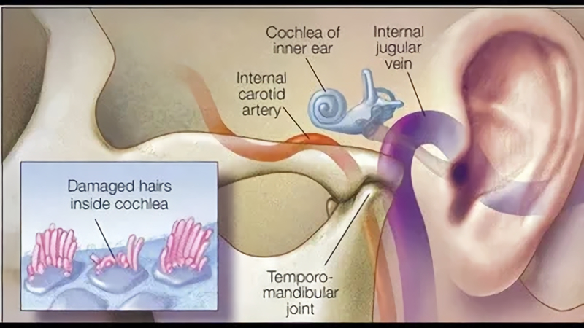
Stem cells therapy for Hearing loss
stem cell therapy involves transplanting new stem cells into the inner ears. The delicate hairs inside our cochlea, or inner ear, help us hear.
Damage to these hairs can lead to permanent hearing loss
There has been success in re-growing cochlea sensory hair cells with the use of stem cells.

Slide 26
Stem cells therapy for eyesight
Using embryonic stem cells, scientists are able to grow a thin sheet of totipotent stem cells in the laboratory. When these sheets are trans planted over the damaged retina, the stem cell stimulate renewed repair, eventually restoring vision.

Slide 27
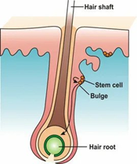
Stem Cell Therapy for Hair Loss
Hair follicles also contain stem cells, and some researches predict research on these follicle stem cells may lead to successes in treating baldness through “hair multiplication”, also known as “hair cloning”.
Treatment is expected to work through taking stem cells from existing follicles, multiplying them in culture, and implanting the new follicles into the scalp.

Slide 28
Challenges and Prospects
cell therapy–related immunotoxicity, immunogenicity, and tumorigenicity are often discussed in preclinical studies.
limited cell survival and limited integration were common obstacles in previous studies with different experimental designs, including cell number, timing of treatment193, and strategies of transplantation
it is important to ensure the genetic stability, generation consistency, and storage safety of stem cells
the mechanism of the effects and biological properties should be further investigated to guide the clinical application

Slide 29
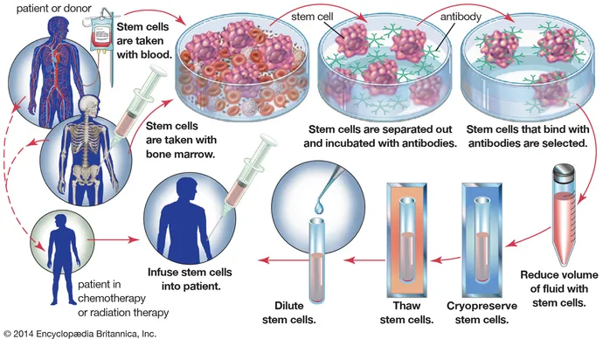

Slide 30
Reference:
Pietro Gentile , Simone Garcovich. 2019 May. Advances in Regenerative Stem Cell Therapy in Androgenic Alopecia and Hair Loss: Wnt pathway, Growth-Factor, and Mesenchymal Stem Cell Signaling Impact Analysis on Cell Growth and Hair Follicle Development. cells,. 16;8(5):466.
Liansheng Gao and colleges. 2020 Nov 5. Progress in Stem Cell Therapy for Spinal Cord Injury. Stem Cells Int.
Eckert M. J., Martin M. J. Trauma: spinal cord injury. The Surgical clinics of North America. 2017;97(5):1031–1045. doi: 10.1016/j.suc.2017.06.008.
Gao L., Xu W., Li T., et al. Stem cell therapy: a promising therapeutic method for intracerebral hemorrhage. Cell Transplantation. 2018;27(12):1809–1824.
Andjela Egger and colleges. 2020 Sep 2. Advances in Stem Cell-Based Therapy for Hair Loss. HHS Author Manuscripts.
Sujay Khandpur and colleges. 2021. Stem cell therapy in dermatology Indian Journal of Dermatology.
Wojciech Zakrzewski and colleges. 26 February 2019. Stem cells: past, present, and future. Stem Cell Research & Therapy volume 10, Article number: 68 (2019)
https://yandex.com/images/search?text=stem%20cell%20therapy%20for%20wound&family=yes&from=tabbar
https://www.dvcstem.com/post/stem-cell-therapy
https://www.nature.com/articles/nindia.2019.163
Paul Knoepfler knoepfler.Ph.D. November 2, 2021. Review of stem cell therapy for hair loss. The Niche.

Slide 31
Thank you

