Slide 1
Presented By: Dr Ghaderi
Heat sterilization

Slide 2
Cont.
For pharmaceutical products, the most frequently applied standard is that the probability, post-sterilization, of a non-sterile unit is 1 in 1 million units processed (i.e. 10^-6).

Slide 3
D-value
Resistance of an organism to a sterilizing agent can be described by means of the D-value
For heat and radiation treatments, respectively, this is defined as the time taken at a fixed temperature or the radiation dose required to achieve a 90% reduction in viable cells

Slide 4
Cont.

Slide 5
Z-value
In order to assess the influence of temperature changes on thermal resistance a relationship between temperature and log D-value can be developed, leading to the expression of a z-value
Represents the increase in temperature needed to reduce the D-value of an organism by 90%.

Slide 7
Inactivation factor (IF)
The sterilization protocol necessary to achieve this with any given organism of known D-value can be established from the inactivation factor (IF) which may be defined as
where t is the contact time (for a heat or gaseous sterilization process) or dose (for ionizing radiation)
D is the D-value appropriate to the process employed.

Slide 8
Inactivation factors (IF) for selected sterilization protocols and their corresponding biological indicator (BI) organisms

Slide 9
Method selection
Product properties
Low toxicity
Based on GMP requirements
Variables can be controlled
Sensitivity of microorganisms

Slide 10
Cont.
The European Pharmacopoeia (2002) recognizes
five methods for the sterilization of pharmaceutical products. These are:
Steam sterilization (heating in an autoclave)
dry heat
ionizing radiation
gas sterilization
filtration

Slide 11
Heat sterilization
Heat is the most reliable and widely used means of sterilization, affording its antimicrobial activity
through destruction of enzymes and other essential cell constituents

Slide 12
Cont.
These lethal events proceed most rapidly in a fully hydrated state, thus requiring a lower heat input (temperature and time) under conditions of high humidity where denaturation and hydrolysis reactions predominate, rather than in the dry state where oxidative changes take place.

Slide 13
Cont.
This method of sterilization is limited to thermostable products, but can be applied to both
moisture-sensitive and moisture-resistant items for
which dry (160–180°C) and moist (121–134°C).

Slide 14
Cont.

Slide 15
Cont.
This involves following the temperature profile of a load, integrating the heat input(as a measure of lethality), and converting it to the equivalent time at the standard temperature of121°c.

Slide 16
The overall lethality of any process can be deduced and is defined as the Fvalue
This expresses heat treatment at any temperature as equal to that of a certain number of minutes at 121°C.

Slide 17
Cont.

Slide 18
Cont.
F values may be calculated either from the ‘area under the curve’ of a plot of autoclave temperature against time constructed
Application of the F-value concept has been
largely restricted to steam sterilization processes

Slide 19
Moist heat sterilization
Sterilization by moist heat usually involves the
use of steam at temperatures in the range
121–134°C.
Standard temperature/time cycles for bottled fluids and porous loads (e.g. surgical dressings) are 121°C for 15 minutes and 134°C for 3 minutes.

Slide 22
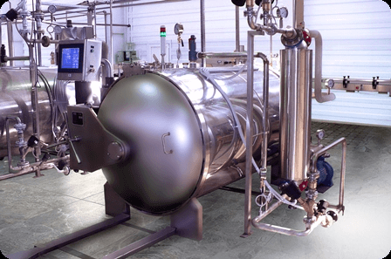
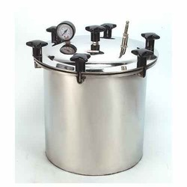
Autoclave types
Industrial Autoclave/Instrumental:400 to 800 liters
Bench Autoclave/Portable

Slide 24
Cont.
Bottle fluid: employing a minimum temperature of 121°C.
Porous Load: operated at a minimum temperature of 134°C

Slide 25
Moist heat sterilization stages
Air removal and steam admission
Heating-up and exposure
Drying or cooling

Slide 26
Dry heat
The lethal effects of dry heat on microorganisms are due largely to oxidative processes which are less effective than the hydrolytic damage which results from exposure to steam.

Slide 27
Dry heat
Dry heat sterilization usually employs higher temperatures in the range 160–180°C and requires exposure times of up to 2 hours depending upon the temperature employed
Resistance varies markedly depending upon their degree of dryness
Was partly responsible for variations in recommended exposure temperatures and times in different pharmacopoeias

Slide 28
Cont.
Glassware and metal surgical instruments (where its good penetrability and non-corrosive nature are of benefit), non-aqueous thermostable liquids and thermostable powders.
Hospitals
In practice, the range of materials that are actually subjected to dry heat sterilization is quite limited.

Slide 29
Cont.
It may also destroy bacterial endotoxin
For the purposes of depyrogenation of glass, temperatures of approximately 250°C are used.
F-value: describes the lethality of a dry heat process in terms of the equivalent number of minutes exposure at 170°c.

Slide 30
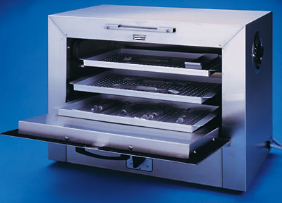
Cont.
Dry heat sterilization is usually carried out in a hot air oven which comprises an insulated polished stainless steel chamber, with a usual capacity of up to 250 liters.

Slide 31
Recent sterilizer developments have led to the use
of dry heat sterilizing tunnels where heat transfer is
achieved by infrared irradiation or by forced convection in filtered laminar airflow tunnels. Items to be sterilized are placed on a conveyer belt and pass through a high temperature zone (250–300+ °C) over a period of several minutes.

Slide 32


خسته نباشید

Slide 33
Quiz
The initial microbial load of a product is 10^6. D value of selected method is 1.5 minutes. Calculate the time required to sterilize the product.

